Slide 1
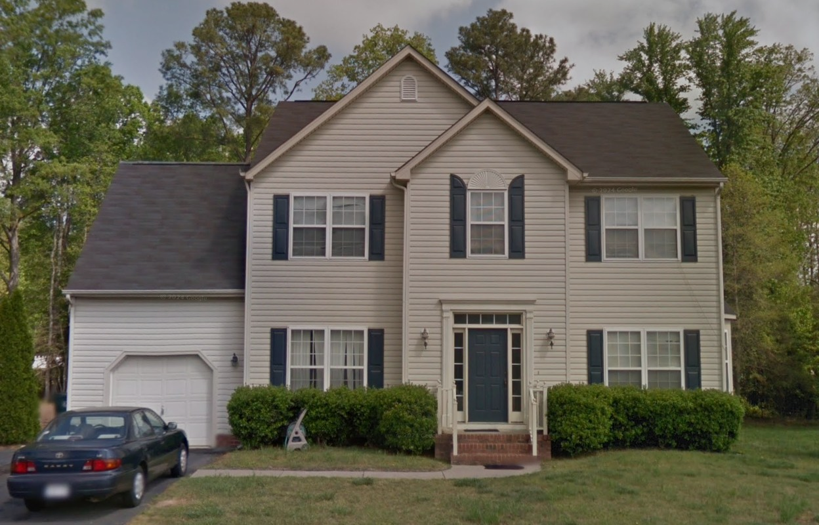
Decision Modeling for Residential Solar Panel Installation
SCMA-642-001 DECISION AND RISK ANALYTICS
Adhyayan Amit Jain
Gauri V Nair
Jesin K Joy
Mariam Yakoub
Notes:
Good afternoon, everyone.
Today, we’ll walk you through our decision model for whether or not to install solar panels at home.
We considered not just costs, but also real-life factors like weather, electricity prices, maintenance, and household energy use.
Let's dive in!

Slide 2
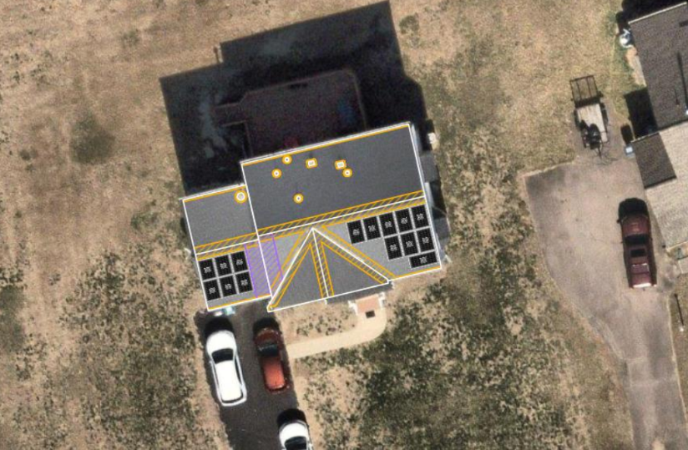
The Decision
Primary Decision: Should the homeowner install solar panels or not install?
Secondary Decision (If Installing): Choose a payment method: → Pay upfront → Finance through loan
Objective: Identify the most cost-effective strategy over a 30-year period considering uncertainties like:
Weather and climate variability
Electricity rate trends
Household energy consumption
System degradation and maintenance
Participation in Virtual Power Plant (VPP) programs
Notes:
The main decision we’re modeling is simple: Should we install solar panels or not?
And if we do install, what is the best way to pay for it — upfront or through financing?
All the uncertainties and possible outcomes branch from this point.

Slide 3
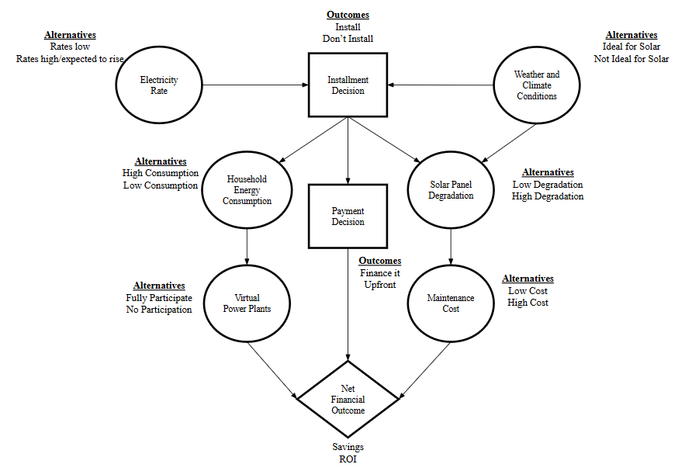
Influence Diagram
Notes:
Here we’ve mapped out all the factors that influence our decision using an influence diagram. At the center is our main decision: whether to install solar panels or not.
This decision is influenced by key uncertainties like:
Electricity rate trends — will they rise or stay low?
Weather and climate conditions — whether the area is ideal for solar.
Household energy consumption — whether it’s high or low.
Degradation rate of the panels — how fast their efficiency drops.
Maintenance costs — whether they stay low or become expensive.
And also, whether we choose to participate in a Virtual Power Plant program, which could offer extra savings.
All of these ultimately affect the financial outcome of the project — whether it results in savings or not.

Slide 4
Key Data Inputs & Their Sources
Average Grid Rate Used: $0.195/kWh
(Blended rate of current $0.13 and future $0.26)
Solar Output Estimate: 22.65 kWh/day
(Average annual output = 8,266 kWh/year)
Daily Energy Consumption Estimates
Panel Degradation
Conservative: 17.7 kWh/day
Progressive: 31.6 kWh/day
(Based on historical use + lifestyle changes like EVs, new appliances)
Low: 0.25%/year
High: 0.80%/year
(From NREL benchmarks)
Maintenance Costs
Utility Rate Trend Probability
Low: $75/year
High: $250/year
(EnergySage + Forbes data)
Increase: 75%
Same/Decrease: 25%
(Based on historical price growth and EIA data)
Data derived from NREL, EnergySage, and actual consumption at Yacoub residence.

Slide 5
Why These Values? – Assumptions and Influencing Factors
Factor | Value(s) Used | Why These?
Degradation | 0.25% (Low), 0.80% (High) | Low: REC panels = Tier-1, industry norm (NREL) High: Rare but possible under harsh climate or poor upkeep
Maintenance | $75 (Low), $250 (High) | Low: DIY cleaning, warranties, microinverters High: Pro cleaning, aging system, climate wear
Utility Rates | $0.13 (Now), $0.26 (Future), Avg: $0.195 75% chance of increase | EIA data shows 3% avg annual rise Push for renewables increases grid upgrades (more cost)
Daily Consumption | 17.7 vs. 31.6 kWh/day | Based on: 17.7: 95% of historical avg 31.6: EV + new appliances forecast
Solar Output | 22.65 kWh/day | Derived from: 6.3 kW × 5.5 PSH × 85% efficiency Based on location (Virginia) and PVWatts data
Weather | 57.5% Sunny, 42.5% Cloudy | Based on 30-year NOAA data for Virginia (210 sunny days/year)

Slide 6
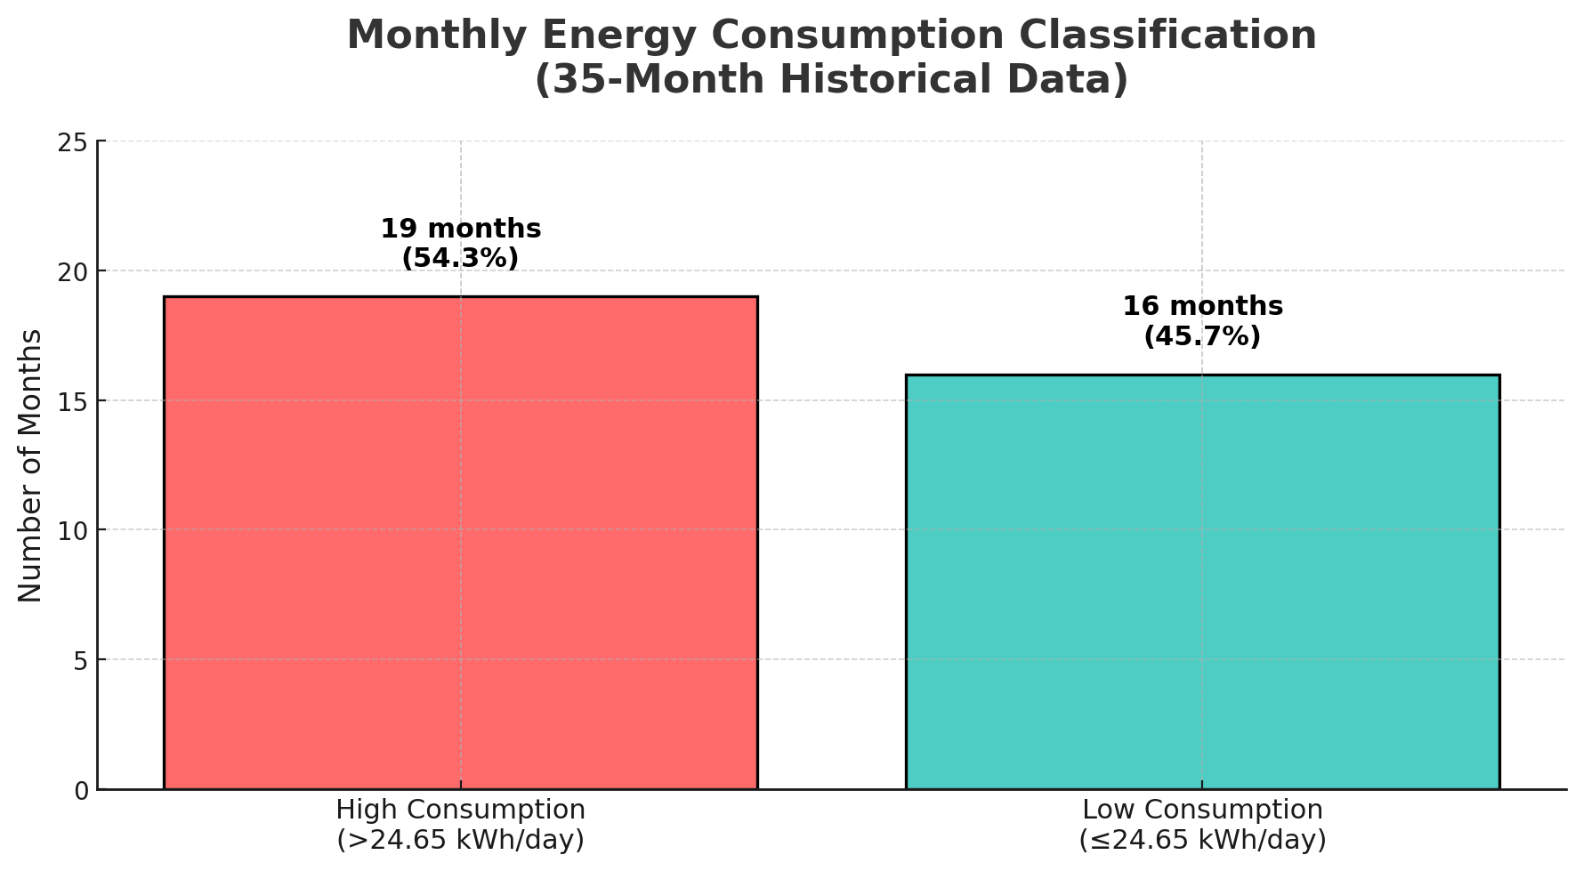
How We Estimated Consumption Scenarios
Low Consumption: Based on 95% of historical average (LEDs, thermostat upgrades)
High Consumption: Includes EV charging (9–10 kWh/day) + new appliances
Probabilities Based on Past 35 Months:
High = 54.3%
Low = 45.7%
(Threshold set at 24.65 kWh/day)

Slide 7
Energy Consumption Modeling & Threshold Justification
Low Consumption (~17.7 kWh/day):
Based on 95% of past 12-month daily avg (18.6 kWh/day)
Assumes LED upgrades, smart thermostats, no major appliance additions
High Consumption (~31.6 kWh/day):
Includes: EV charging (~9–10 kWh/day) + dishwasher/fridge (~2–3 kWh/day)
Lifestyle upgrade modeled as realistic probability
Threshold for Classification:
Midpoint of 17.7 and 31.6 → 24.65 kWh/day
Applied to 35-month data to compute probabilities
Probability Estimates:
High (>24.65): 19 months → 54.3%
Low (≤24.65): 16 months → 45.7%

Slide 8
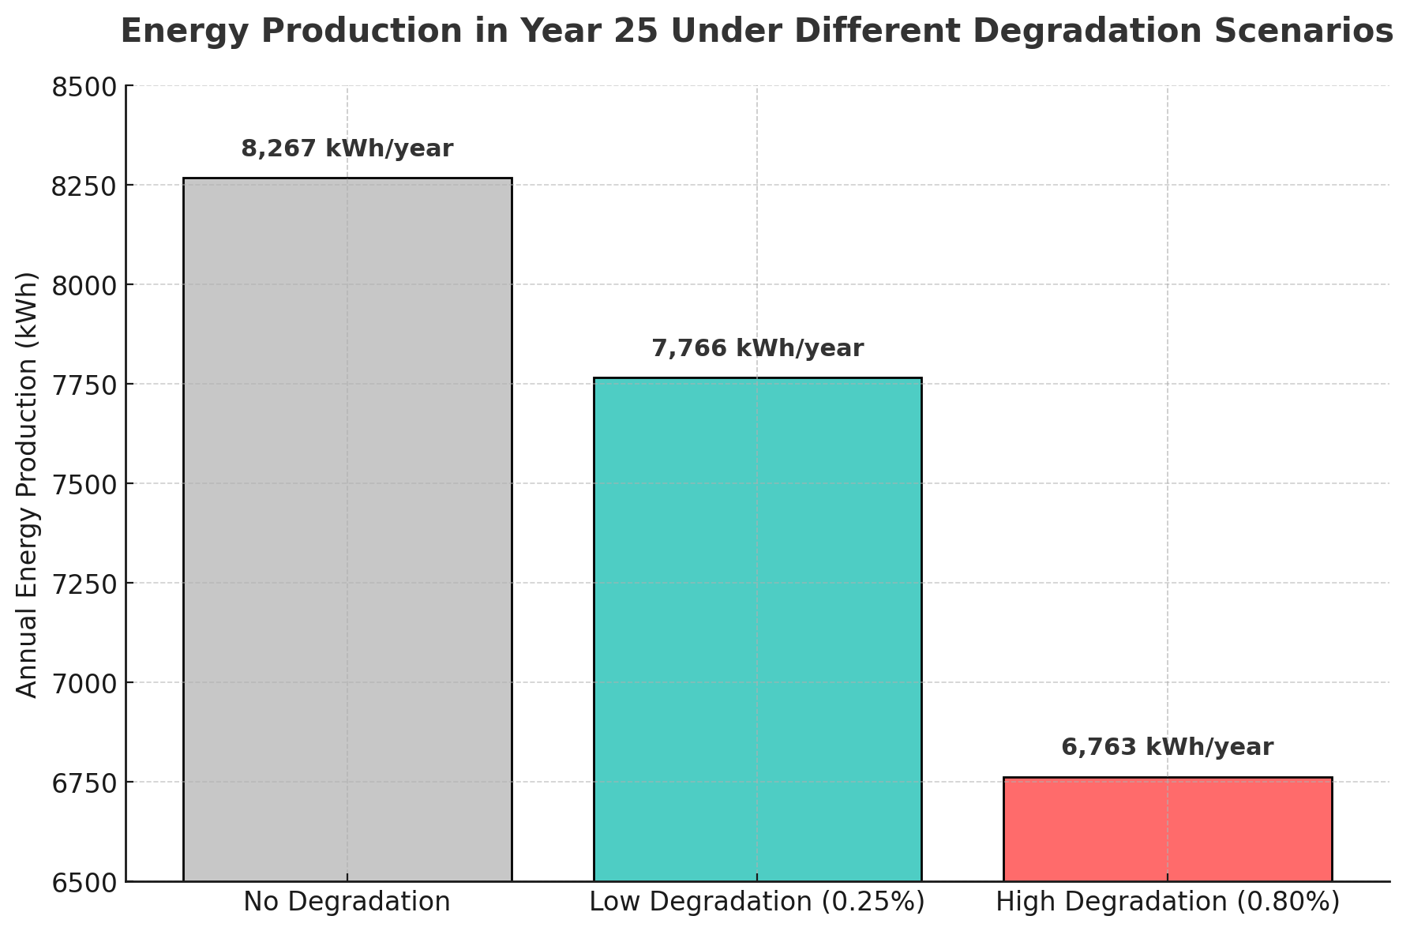
Solar Panel Degradation & Its Cost
Used a compound degradation formula over 25 years:
Ea = Σ[P₀ × 365 × (1 - D)^y]
Low Degradation (0.25%) → Cost: $1,284
High Degradation (0.80%) → Cost: $3,935
Probabilities Used:
80% Low
20% High
(Industry data from NREL and REC panels used)

Slide 9
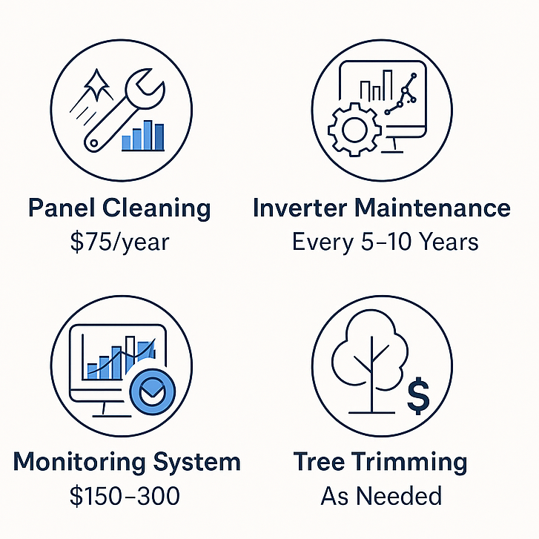
Maintenance Scenarios
Low Maintenance
(DIY, warranty coverage)
$1,875 over 25 yrs
Probability: 70% Low
High Maintenance
(pro cleaning, tech checks)
$6,250 over 25 yrs
Probabilities: 30% High

Slide 10
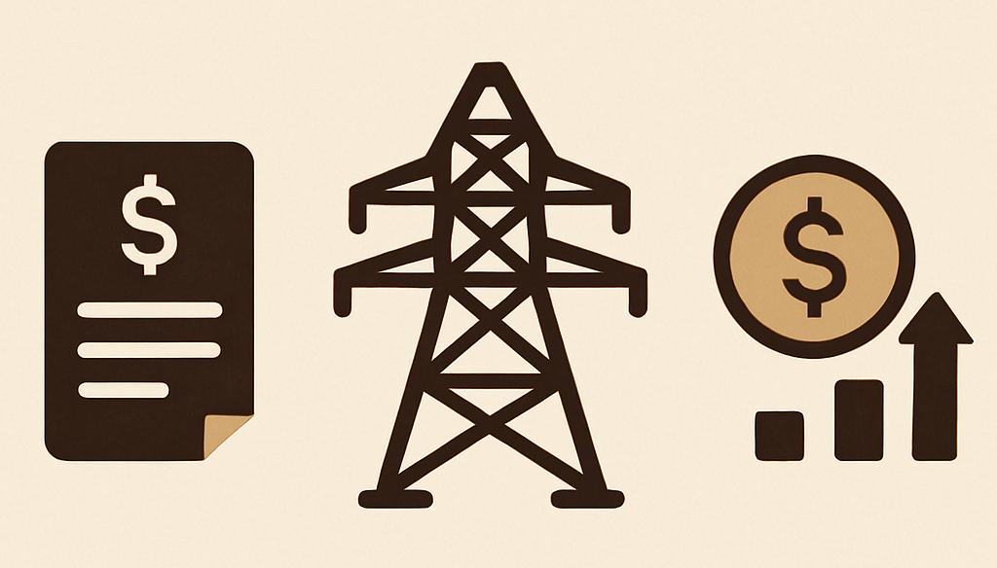
Utility Rate Trends & Assumptions
Grid rates used:
Base: $0.195/kWh (for cost/saving calc)
Worst case: $0.26
Current: $0.13
Probability of Increase Over 30 Years: 75%
(EIA & industry history show ~3%/yr avg growth)

Slide 11
Data
Quantity | Value | Source
Probability of Sunny Day | 0.575 | National Centers for Environmental Information (NOAA);
Probability of Cloudy Day | 0.425 | National Centers for Environmental Information (NOAA);
Probability of High Energy Consumption | 0.543 | Derived from 19 of 35 months with >24.65 kWh/day average (User-provided data)
Probability of Low Energy Consumption | 0.457 | Derived from 16 of 35 months with ≤24.65 kWh/day average (User-provided data)
Probability of Low Degradation (≤ 0.5% per year) | 0.80 | National Renewable Energy Laboratory (NREL); Tier-1 panel industry standard rates
Probability of High Degradation (> 0.5% per year) | 0.20 | NREL panel studies; worse conditions or poor quality
Probability of Low Maintenance Over 30 Years | 0.70 | EnergySage, NREL, Forbes; REC panels, microinverters, and moderate climate assumptions
Probability of High Maintenance Over 30 Years | 0.30 | EnergySage, NREL; Accounts for harsher climate, aging, professional services
Probability of Utility Rates Increasing (next 30 years) | 0.75 | Historical ~3% growth (EIA); Solar planning models assume upward trend
Probability of Utility Rates Staying Same/Decreasing | 0.25 | Based on shift to renewables, grid reforms; conservative assumption from analysis
Notes:
To make our model realistic, we used actual probabilities based on trusted sources.
This table shows the probabilities for each of the uncertainties in our model. These numbers aren’t guesses — they’re based on real data.
For example:
The chance of a sunny day is 57.5%, based on NOAA data.
High household consumption has a probability of about 54.3%, calculated from past energy usage.
Low panel degradation — 0.25% per year — has an 80% chance, based on industry data from NREL.
There's a 75% chance that electricity rates will increase over the next 30 years, based on historical trends.
We used these probabilities in our decision tree model to simulate realistic long-term outcomes.
All of this data feeds into our decision tree calculations.

Slide 12
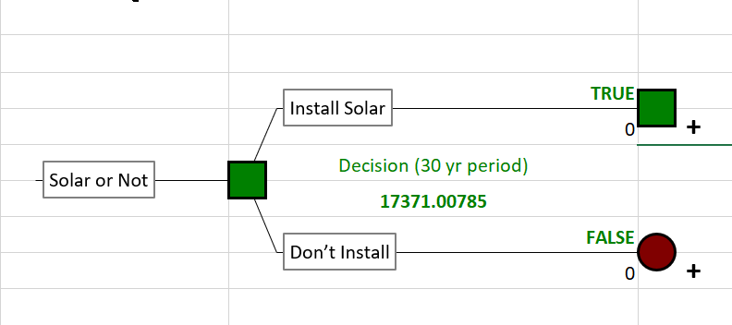
Main Decision
Notes:
This is the top of our decision tree. The first decision is whether to install solar panels or not.
If we choose not to install, the outcome is driven by utility rate trends and energy use. But if we do install, we then face another decision — how to pay: upfront or through financing.
From there, the tree branches out further based on the different uncertainties, such as degradation, maintenance, and household consumption.

Slide 13
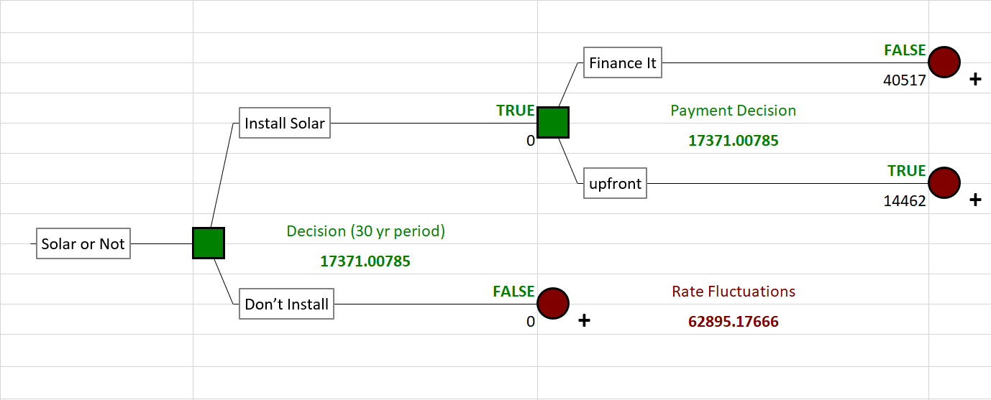
Payment Strategy
Notes:
Here we explore the payment options in detail. If we install, we can either finance the system over 30 years or pay upfront.
Paying upfront costs more in the beginning but saves thousands in interest over time specifically 22000 usd in interest which itself is more than the cost of the system. Financing spreads the cost out and is easier on cash flow, but the total cost is higher due to loan interest.
Our tree shows how each option performs depending on future conditions like utility rates and panel performance.

Slide 14
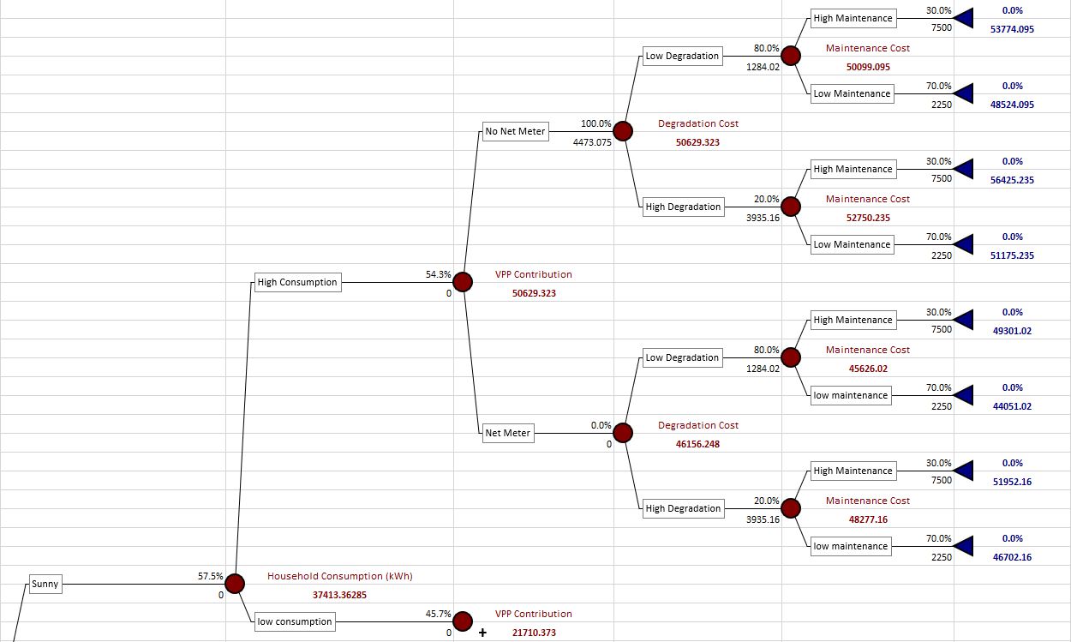
Projected Costs Under Different Conditions - Sunny
Notes:
This part of the model shows outcomes under sunny conditions — where solar panels are generating more electricity.
Here, you can see that when we install the system and have sunny weather, the cost savings are strong, especially under low consumption scenarios. Even when maintenance or degradation is on the higher side, the net savings from solar outperform the 'do nothing' option.

Slide 15
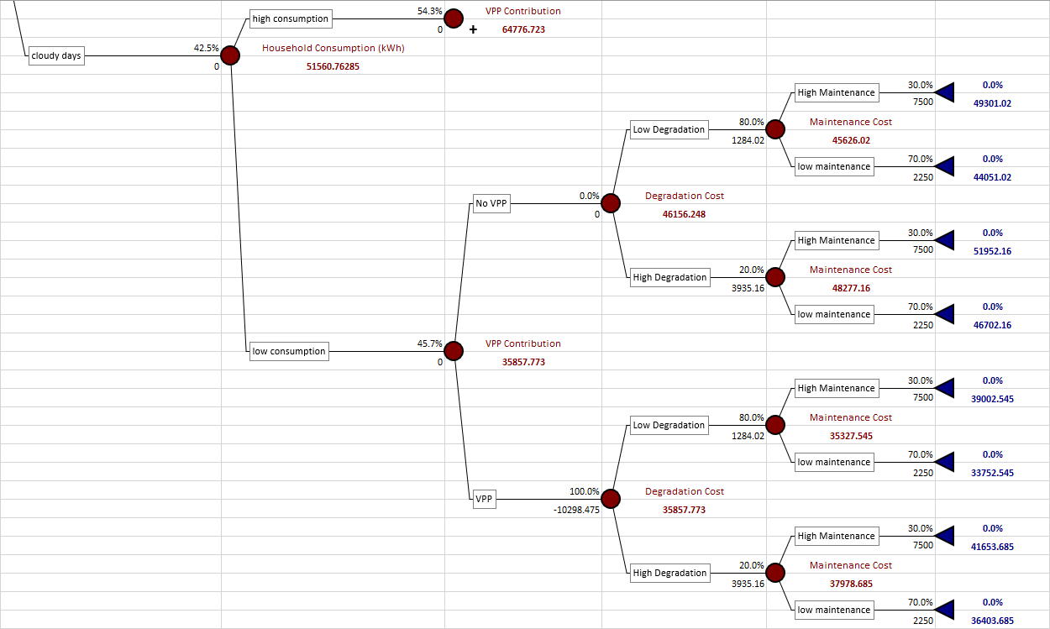
Projected Costs Under Different Conditions - Cloudy
Notes:
Now we look at cloudy conditions, where solar production is reduced.
In this scenario, the panels produce less energy, so we rely more on the grid. This increases long-term costs, especially when consumption is high or maintenance is expensive.
However, even in this case, installing solar often still provides financial benefits — just not as high as in sunny scenarios.
Now i pass it on to gauri for further discussion

Slide 16
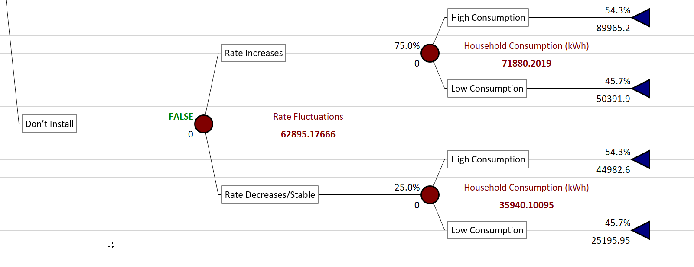
Projected Costs Without Solar Installation
Notes:
This is the outcome if we don’t install solar at all.
We remain fully dependent on the grid, and with electricity rates expected to increase by about 3% annually, the total cost over 30 years can reach nearly $65,000.
There are no solar savings here — just increasing utility bills, especially for households with high energy use.

Slide 17
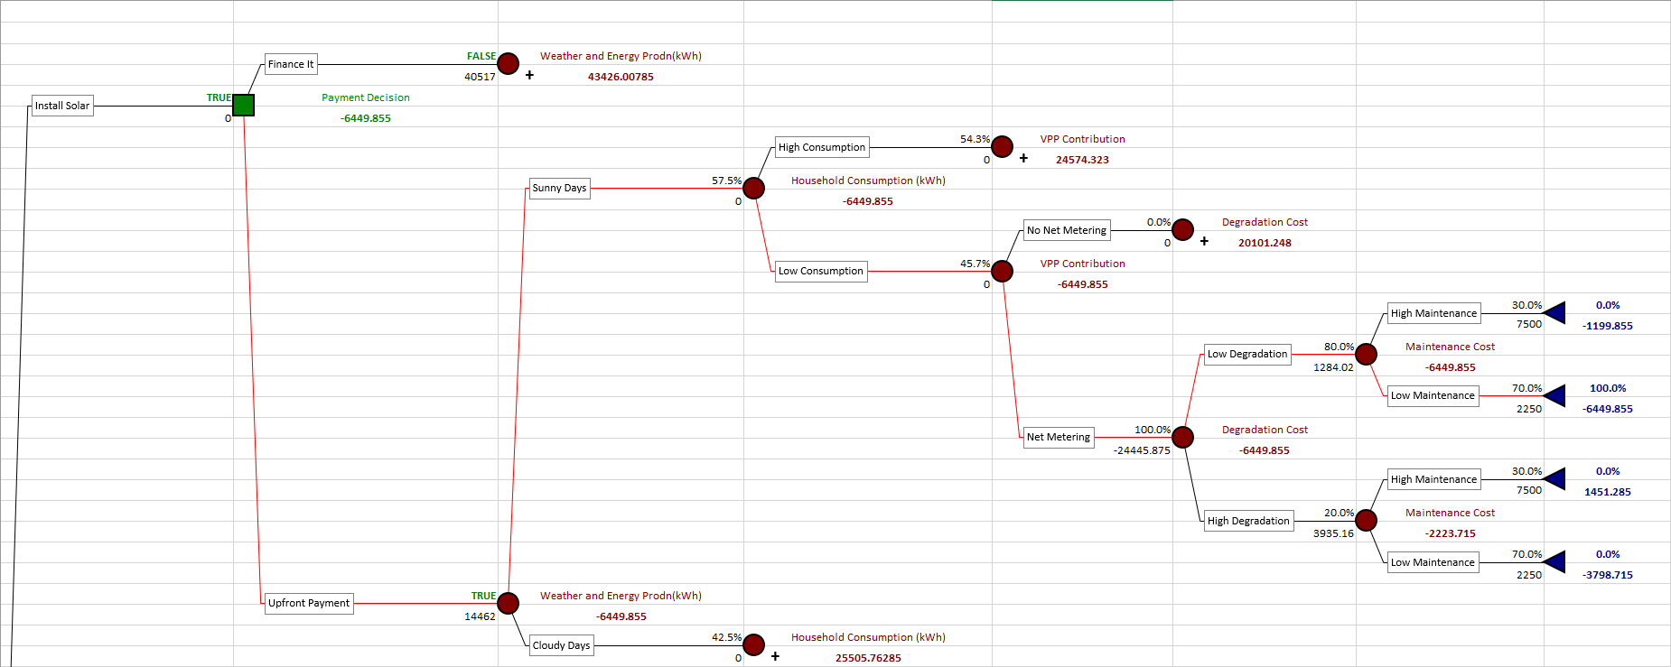
Final Recommendation Based on Cost-Benefit Analysis
Notes:
After analyzing all these scenarios — sunny, cloudy, different degradation rates, and various consumption levels — it’s clear that installing solar panels provides better financial outcomes in most cases.
The savings are highest under sunny conditions and low usage, but even in less ideal cases, solar often still wins.
Our recommendation is to install solar panels, and where possible, pay upfront to maximize long-term savings.

Slide 18
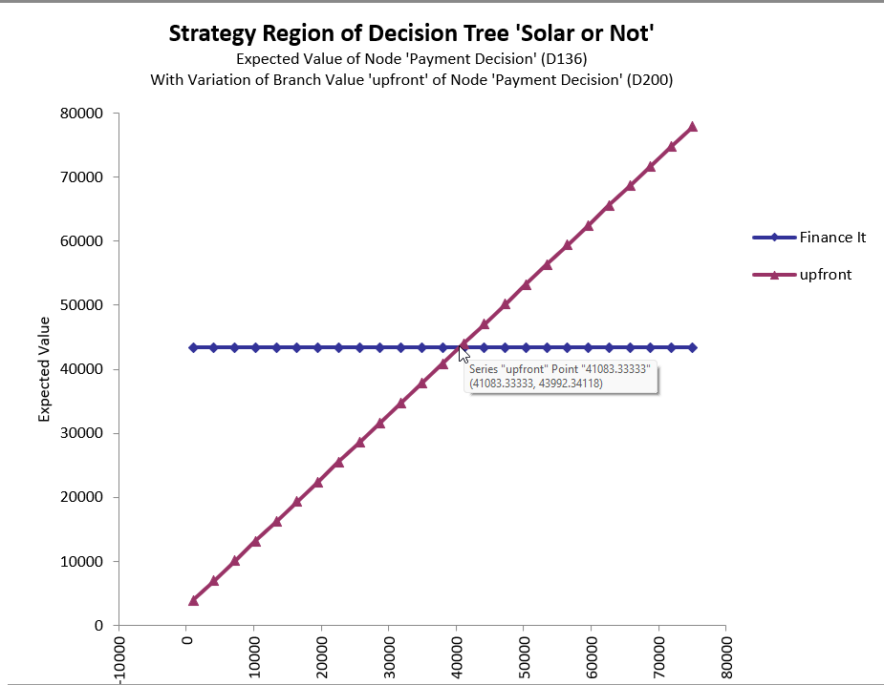
Sensitivity Analysis - Payment Node
Notes:
This sensitivity analysis focuses just on the payment method: upfront vs financing.
It shows that while both options are better than doing nothing, paying upfront gives you a better return on investment. That’s because you avoid long-term interest payments and fully benefit from the savings right away.

Slide 19
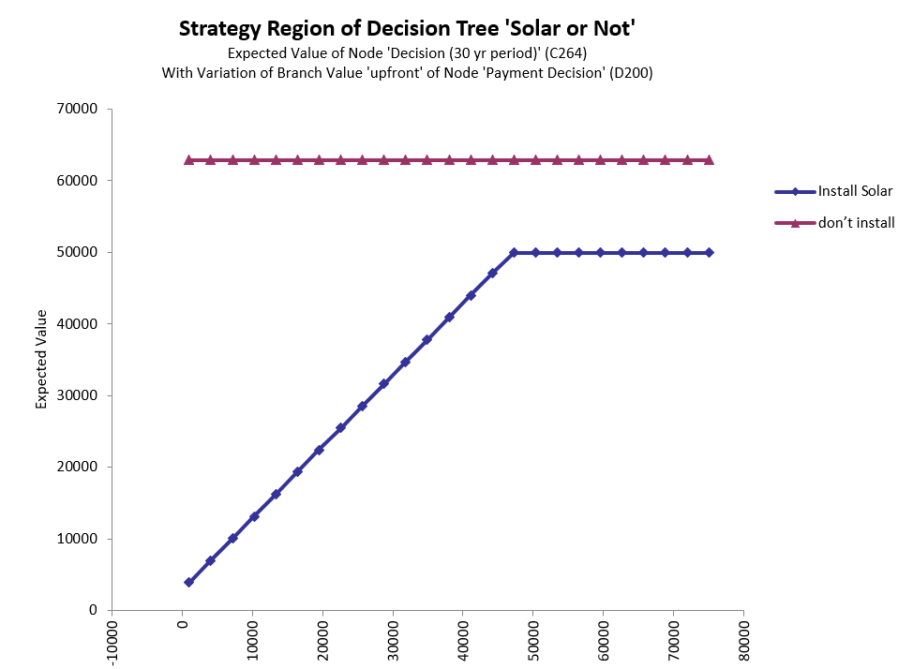
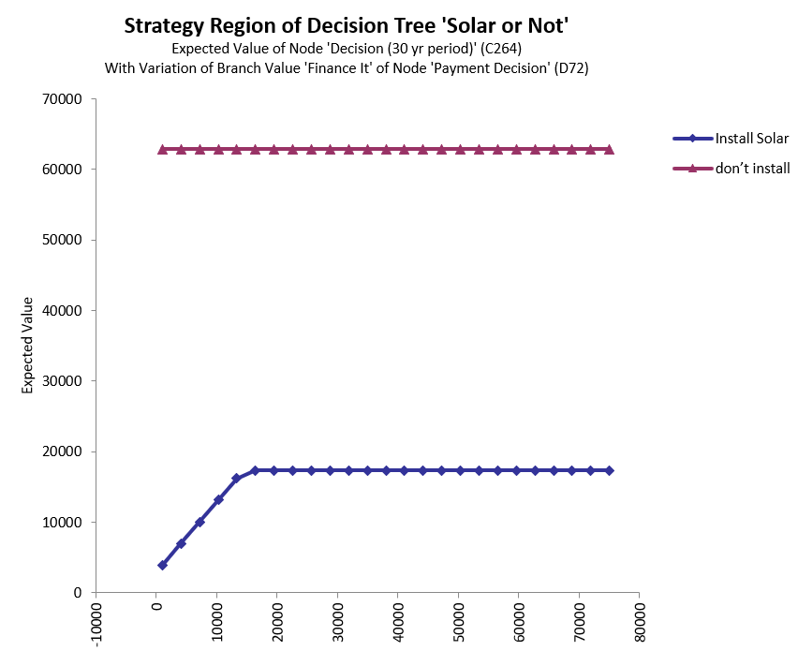
Sensitivity Analysis - Entire Model
Upfront Scenario
Financing Scenario
Notes:
This chart looks at the sensitivity of the entire model.
We tested how changes in different probabilities affect the final decision. The model is most sensitive to electricity rate changes and energy consumption levels.
But the overall recommendation — to install solar — remains consistent across all tested variations.

Slide 20
Decision Clarity
Even though solar installation has an upfront cost, it leads to significant savings over time — especially when utility rates are likely to rise.
Household energy use may vary, but most scenarios show solar reduces long-term expenses compared to doing nothing.
System performance can change due to weather, panel degradation, and maintenance needs — but these are manageable and factored into the model.
Even with potential maintenance or high energy use, solar remains cost-effective in most paths.
Not installing solar leads to higher energy bills, especially under high consumption and increasing rate conditions.
Overall, the information gathered shows that installing solar — with or without Net Metering — is the smarter financial choice over 30 years.
Notes:
To summarize our decision clarity: Even though installing solar requires upfront investment and involves some uncertainty, the potential savings far outweigh the risks.
Rising utility rates, especially when combined with high household usage, make solar a smarter long-term choice.
And since we’ve included degradation, maintenance, and weather effects in the model, we’re confident in our analysis.

Slide 21
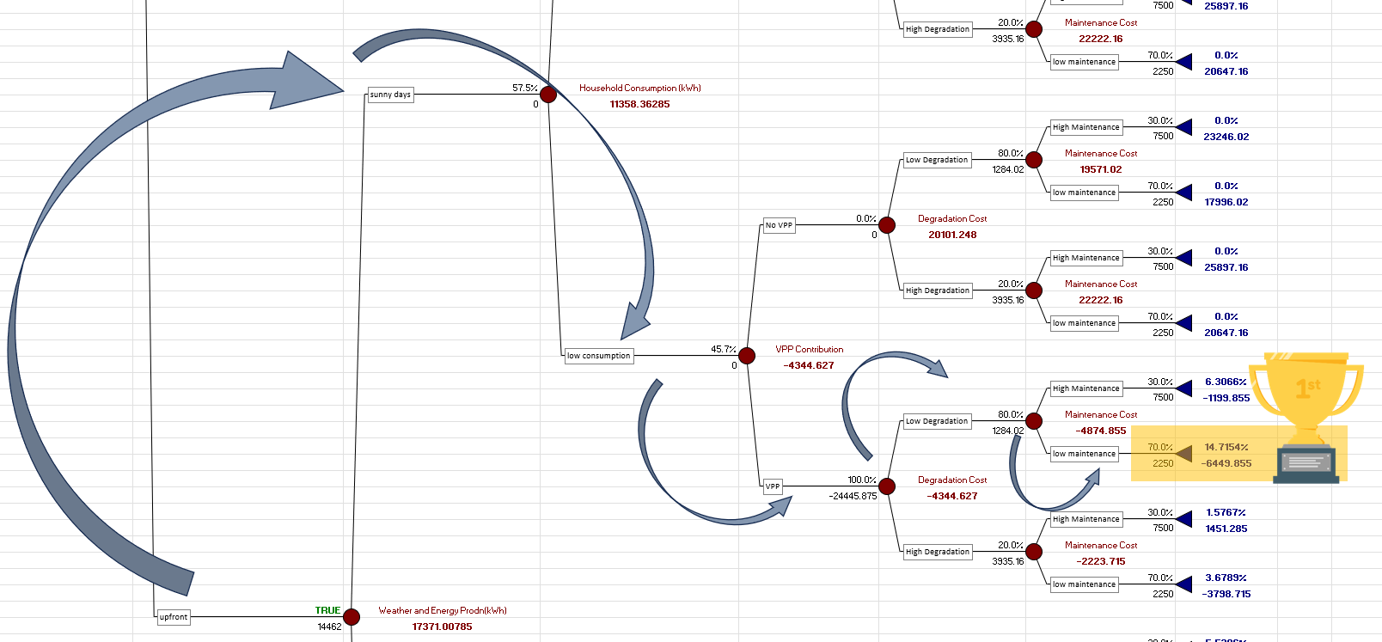
Final Decision
Notes:
This branch wins because it stacks all the best-case factors (net metering, low usage, low degradation, low maintenance, and a VPP credit), resulting in the lowest total cost of all branches.Net Metering is active ( selling energy back to the grid, which brings down your cost).Low degradation and low maintenance keep the ongoing costs very minimal.The combination of credits and low operating expenses leads to this being the most economical choice.

